Slide 1

VJJA Annual Business Meeting and Awards Ceremony
in conjunction with the 44th Fall Juvenile Justice Institute
November 5, 2020
➢ Annual Business Meeting
  Minutes
  Membership Report
  Treasurer’s Report
➢ Awards Ceremony
➢ Scholarship Presentation
➢ Closing and District Gifts
And the Winner Is …
And the Winner Is …

Slide 2
VJJA Annual Business Meeting and Awards Ceremony
in conjunction with the 44th Fall Juvenile Justice Institute
November 5, 2020
Annual Awards Ceremony
Meritorious Award in the Area of Court Services
Meritorious Award in the Area of Community Service
Meritorious Award in the Area of Residential Services
Meritorious Award in the Area of Administration

Slide 3
VJJA Annual Business Meeting and Awards Ceremony
in conjunction with the 44th Fall Juvenile Justice Institute
November 5, 2020
2020 VJJA Meritorious Award Winner
in the Area of Court Services
And the Winner is …

Slide 4
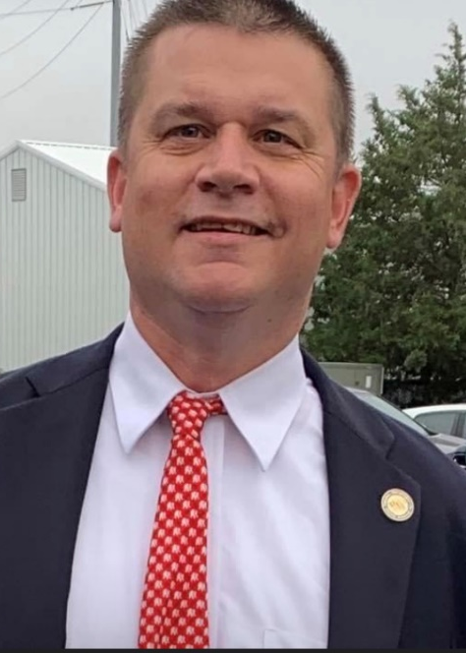
2020 VJJA Meritorious Award
in the Area of Court Services
 | MATT BOND VJJA Member, Capital District Chapter Probation Supervisor, 14th CSU – Henrico

Slide 5
VJJA Annual Business Meeting and Awards Ceremony
in conjunction with the 44th Fall Juvenile Justice Institute
November 5, 2020
2020 VJJA Meritorious Award Winner
in the Area of Residential Services
And the Winner Is …

Slide 6

2020 VJJA Meritorious Award
in the Area of Residential Services
 | KEVIN JEFFERSON VJJA Member, Capital District Chapter Clinical Manager, Intercept Health: The Summit Transitional Living Program

Slide 7
VJJA Annual Business Meeting and Awards Ceremony
in conjunction with the 44th Fall Juvenile Justice Institute
November 5, 2020
2020 VJJA Meritorious Award Winner
in the Area of Community Service
And the Winner Is …

Slide 8
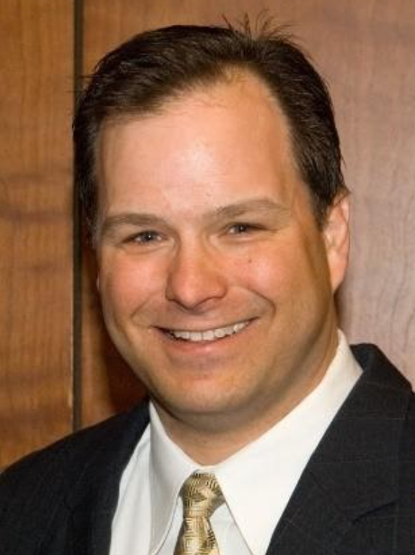
2020 VJJA Meritorious Award
in the Area of Community Service
 | PATRICK SLIFKA VJJA Member, Northern District Chapter Senior Clinical Director National Counseling Group

Slide 9
VJJA Annual Business Meeting and Awards Ceremony
in conjunction with the 44th Fall Juvenile Justice Institute
November 5, 2020
2020 VJJA Meritorious Award Winner
in the Area of Administration
And the Winner Is …

Slide 10

2020 VJJA Meritorious Award
in the Area of Administration
The Entire VA DEPARTMENT OF JUVENILE JUSTICE Partner Agencies and Broader Youth-Serving Community
#WeAreALLinThisTogether

Slide 11
VJJA Annual Business Meeting and Awards Ceremony
in conjunction with the 44th Fall Juvenile Justice Institute
November 5, 2020
2020 Professional Development Scholarships Named in Memory of
Rodney C. Hubbard
and
Robert Shepherd Jr.

Slide 12
2020 VJJA Professional Development Scholarship Named
in Memory of Rodney C. Hubbard
and Robert Shepherd Jr.
Scholarship #1 And the Winner Is …

Slide 13
2020 VJJA Professional Development Scholarship Named
in Memory of Rodney C. Hubbard
and Robert Shepherd Jr.
DAVID HALL Newport News Juvenile Services

Slide 14
2020 VJJA Professional Development Scholarship Named
in Memory of Rodney C. Hubbard
and Robert Shepherd Jr.
Scholarship #2 And the Winner Is …

Slide 15
2020 VJJA Professional Development Scholarship Named
in Memory of Rodney C. Hubbard
and Robert Shepherd Jr.
TRACEY KEATON-JOHNSON Senior Parole Officer Newport News Court Service Unit

Slide 16
VJJA Annual Business Meeting and Awards Ceremony
in conjunction with the 44th Fall Juvenile Justice Institute
November 5, 2020
District Gifts Presented by:
Southwest District Chair
Blue Ridge District Chair
Valley District Chair
Northern District Chair
Capital District Chair
Tidewater District Chair

Slide 17
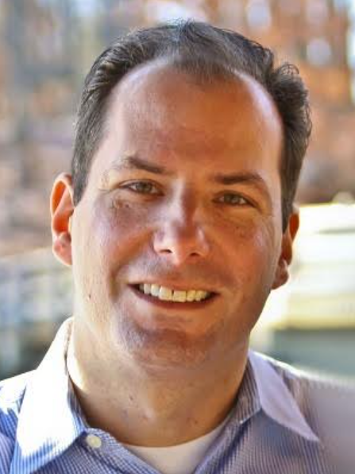
VJJA Annual Business Meeting and Awards Ceremony
in conjunction with the 44th Fall Juvenile Justice Institute
November 5, 2020
2020 VJJA Professional Development Scholarship Named
in Memory of Rodney C. Hubbard
and Robert Shepherd Jr.
Major thanks again to members
Stephan Stark and Patrick Slifka with the
National Counseling Group for the tech support!

